Slide 1
IC 152: Makerspace Laboratory
Line Follower Project:2023-24

Slide 2
Batch: B2
Group Members
Siddharth Singh-230002068
Sidhant Kumar Mohanty-230002069
Sasanipuri Akhil-230002066
Sneha Bains-230002070
Srikant Ravi Jois-230002071

Slide 3
Introduction
The line follower robot is an automated vehicle that follows a visible black line or path on the ground. This visual line represents the path along which the line follower robot travels. You can choose between using a black line on a white surface or a white line on a black surface based on your requirements.

Slide 4
Why line follower robot?
It is an Automatic Movement Robot and can easily work on rechargeable Li-ion batteries
Its basic functions can be altered through amendments in just the Arduino code.
It is a simple and efficient Robo that can also be used for longer distances.
The Net making cost of Robo is very feasible

Slide 5
Basic working principle
Our line follower robot is equipped with infrared transmitters and receivers, which are also referred to as photodiodes. An Arduino is used to analyze the voltage changes that occur when infrared light strikes a white surface and is reflected back toward the IR receiver. An IR receiver doesn't pick up any rays when infrared light strikes a black surface because the light is absorbed by the black surface and isn't reflected back.
In this project, an Arduino receives HIGH input when the IR sensor detects a white surface and LOW input when it detects a black line. An Arduino Uno generates the appropriate output to operate the line follower based on these inputs

Slide 6
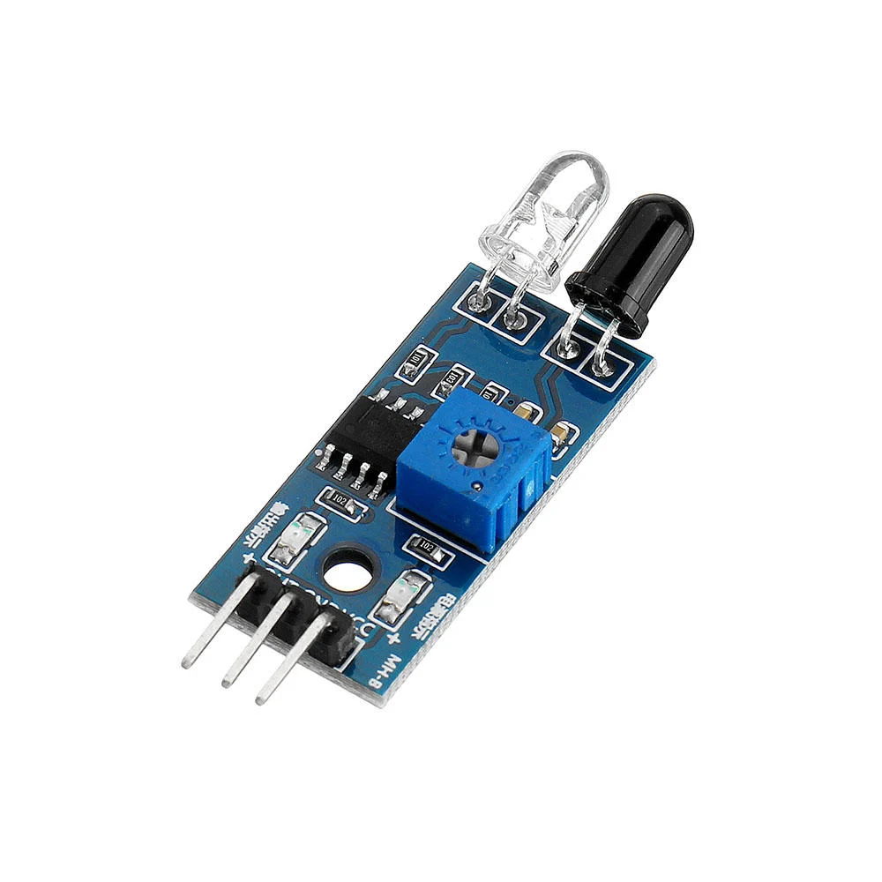

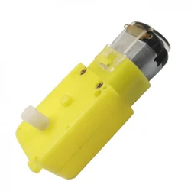
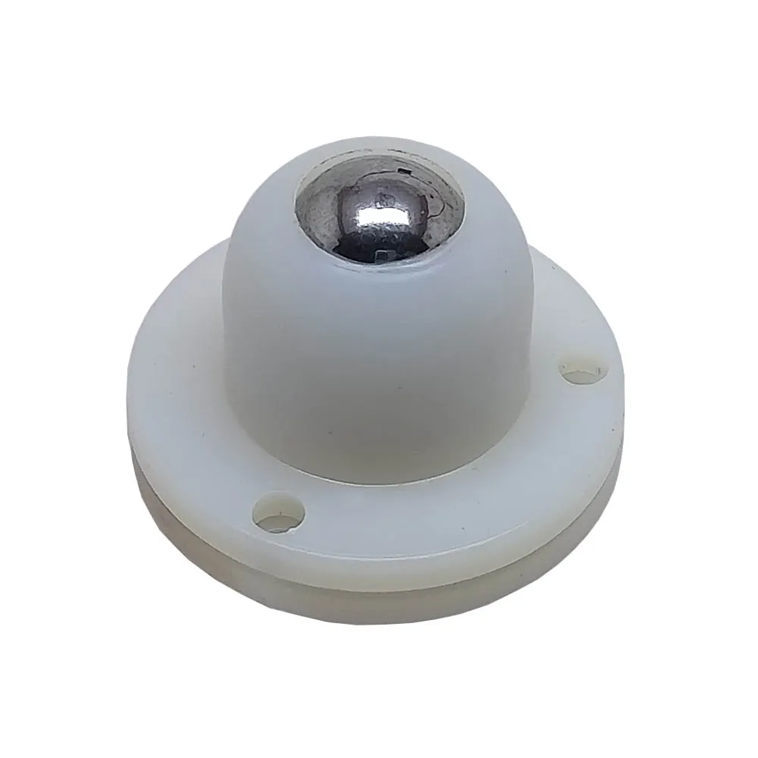
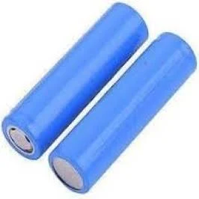
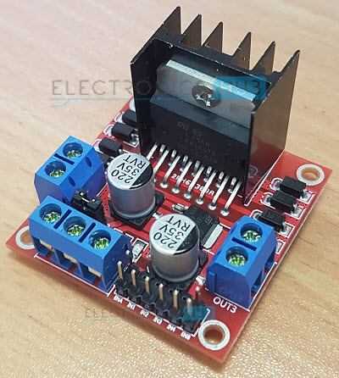
Components used
Arduino Board (UNO)
Jumper Wires
Car chassis
L298 motor driver module
IR sensor module
Rechargeable Li-ion Battery
On-Off- Switch
3-D Printed Wheels
Connecting wires
Soldering iron
Solder wire
Hot Melt Glue Gun
Double-sided tape
Castor Wheel
Water pump
Geared motor
Vinyl pipe

Slide 7
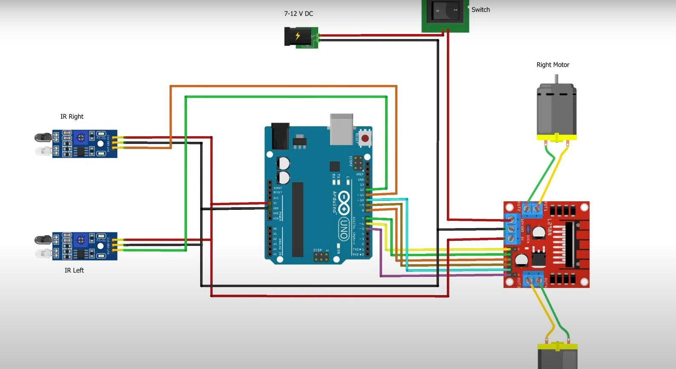
Circuit Diagram

Slide 8
COMPONENTS
ARDUINO UNO;
The Arduino Uno microcontroller is an 8-bit ATmega328P. It uses parts like a voltage regulator, crystal oscillator, serial communication, etc., to support the microcontroller. There are 14 digital I/O pins on it (six of which can be used for PWM). It features an ICSP header, a reset button, a power barrel jack, a USB port, and six distinct analog input pins. Using a type B USB cable, you can program this board using the Arduino IDE (Integrated Development Environment) platform. This board can be powered by either an external voltage between 7 and 20 volts or a USB cable.

Slide 9
COMPONENTS
2. INFRARED SENSORS
An infrared sensor uses light emission to sense specific environmental factors. All objects in the infrared spectrum emit some kind of thermal radiation that is undetectable to the human eye, but that can be detected by an IR sensor. In this instance, the IR photodiode serves as a detector and the IR LED as an emitter. The IR light is produced by an IR LED, and the photodiode is sensitive to it. The output voltages and resistances of the photodiode will alter in proportion to the amount of infrared light that it receives when it is exposed to it.

Slide 10
COMPONENTS
3. L289N MOTOR DRIVER
Among the simplest and most effective methods for controlling DC motors is L298N. The DC motors' speed and direction of rotation are managed by the two-channel motor driver. This motor driver module, model number L298N, has a high power output. Motors that are DC and stepper are driven by it. This motor driver is an integrated circuit that includes a 78M05 5V voltage regulator, resistors, capacitors, power LED, and a 5V jumper in addition to an L298N motor driver IC. The 78M05 voltage regulator is enabled when the jumper is inserted. The voltage regulator powers the internal circuitry when the power supply is less than or equal to 12 volts. The jumper should not be installed and should provide a separate 5 volts to power the internal circuitry when the power supply is greater than 12 volts. In this case, Motor A and Motor B's speed control pins are ENA and ENB. Motor A and Motor B's direction control pins are IN1, IN2, IN3, and IN4.

Slide 11
COMPONENTS
4. BATTERY OPERATED MOTORS
A battery-operated motor (BO motor) is referred to as such. These motors are frequently utilized in hobby-level projects where a small DC motor is needed as a basic actuator. At lower operating voltages, linear motors from the BO series offer good torque and rpm. BO motors are offered in DC plastic gear BO, single-shaft, and dual-shaft configurations. These motors use very little current. We used four single-shaft BO motors for this project.

Slide 12
COMPONENTS
5. LITHIUM-ION BATTERY
Rechargeable batteries are those made of lithium-ion material. It's frequently utilized in portable gadgets like cellphones, laptops, electronics, and electric cars. Additionally, their use in aerospace and military applications is becoming more and more common.

Slide 13
Procedure
3-D PRINTING The WHEELS:
1. Design the Wheels
2. Export the Design
3. Prepare 3D Printer
4. Print the Wheels
5. Mounting and testing

Slide 14
Procedure
2)Laser printing the chassis board:
Using a vector graphics program like Fusion 360, design the chassis first before utilizing laser cutting to create the chassis board for a line follower robot. Export the artwork in an SVG or other compatible format. Select a material that is appropriate for laser cutting, such as plywood or acrylic, and configure your laser cutter in accordance with the material requirements. Place the material onto the cutting bed, open the laser cutter software, and modify the cutting parameters. Before beginning the entire cutting process, make sure everything is accurate with a test cut. After the pieces have been cut, assemble the chassis by joining them with the proper fastening techniques. When necessary, attach motors, sensors, and other parts, then test the robot to make sure it functions as intended. Prioritize safety above all else, and for detailed instructions, refer to the laser cutter manual.

Slide 15
Procedure
3)CONNECTIONS AND WIRING:
Here, four BO motors have been utilized. Motors 1 and 2 are linked to the L298N's first channel, while motors 3 and 4 are linked to the motor driver's second channel. Pins 9, 6, 5, and 3 of the Arduino Uno are connected to pins IN1, IN2, IN3, and IN4 pins. This is what we have employed a jumper to connect the enable pins (EN1 and EN2) to +5V. It can be taken out, and the external connection can be made.

Slide 16
Procedure
4)CHANGING OF SPEED:
The robot's bottom has three sensors that monitor the black path continuously. The right wheel turns and the left wheel slows down when the left sensor detects a white surface. When the right wheel senses a white surface, the same procedure is initiated. The castor wheel that is fastened to the front bottom does the turning.

Slide 17
Procedure
5)PLACEMENT OF SENSORS:
One of the most important factors in maximizing a line follower robot's performance is sensor placement. Typically, infrared sensors are placed strategically beneath the chassis of a two-wheeled vehicle. The robot can identify path deviations by positioning two sensors—one on the left and one on the right—so that they straddle the line. The robot's capacity to make accurate and timely adjustments depends on the precise alignment and spacing of these sensors. The ideal location of the sensors is influenced by various factors, including the width of the robot, the line's thickness, and the desired response to turns. Furthermore, maintaining the proper height of the sensors above the surface enhances the dependability of the line-following behavior. The best location for the sensors to operate in a variety of conditions requires trial and error and experimentation.

Slide 18
Procedure
6)CALIBRATION AND TESTING:
In order to ensure optimal performance and accuracy in following predefined paths, line follower robot development must include the critical stages of calibration and testing. The process of calibration entails adjusting the robot's sensors—such as cameras or infrared sensors—so that they can recognize and react to the surface line with precision. Assuring correct alignment and modifying sensor sensitivity and threshold values are some possible steps in this process.

Slide 19
ACTUAL CODE
//Motor one
#define ENA 11
#define IN1 9
#define IN2 10
//Motor two
#define IN3 7
#define IN4 8
#define ENB 6
#define Speed 160 //Speed of motor (Can be adjusted between 0-255)
//irpin
int ir_1 = 1;
int ir_2 = 2;
void setup() {
//Sensor pins
pinMode(ir_1, INPUT);
pinMode(ir_2, INPUT);
//Motor one
pinMode(ENA, OUTPUT);
pinMode(IN1, OUTPUT);
pinMode(IN2, OUTPUT);
//Motor two
pinMode(ENB, OUTPUT);
pinMode(IN3, OUTPUT);
pinMode(IN4, OUTPUT);
}
void loop() {
//reading sensor values
bool SR = digitalRead(ir_1);
bool SL = digitalRead(ir_2);

Slide 20
if (SR == 0 && SL == 0) {
forward();
} else if (SR == 0 && SL==1) {
turnleft();
} else if (SR==1 && SL ==0){
turnright();
}
}
void forward() {
//Function for moving forward
analogWrite(ENA, Speed);
analogWrite(ENB, Speed);
digitalWrite(IN1, HIGH);
digitalWrite(IN2, LOW);
digitalWrite(IN3, HIGH);
digitalWrite(IN4, LOW);
}
void turnright() {
//Function for right turn
analogWrite(ENA, 220);
analogWrite(ENB, 220);
digitalWrite(IN1, HIGH);
digitalWrite(IN2, LOW);
digitalWrite(IN3, LOW);
digitalWrite(IN4, HIGH);
}
void turnleft() {
analogWrite(ENB, 220);
digitalWrite(IN1, LOW);
digitalWrite(IN2, HIGH);
digitalWrite(IN3, HIGH);
digitalWrite(IN4, LOW);
}
void Stop() {
//Function to stop
analogWrite(ENA, 0);
analogWrite(ENB, 0);
digitalWrite(IN1, LOW);
digitalWrite(IN2, LOW);
digitalWrite(IN3, LOW);
digitalWrite(IN4, LOW);
}

Slide 21
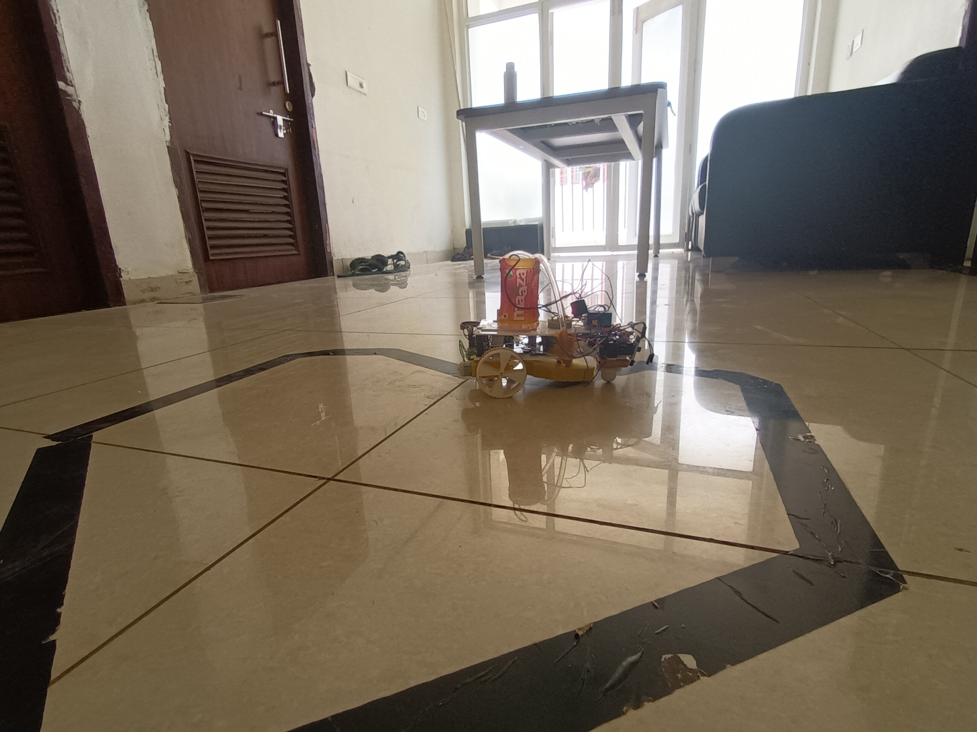
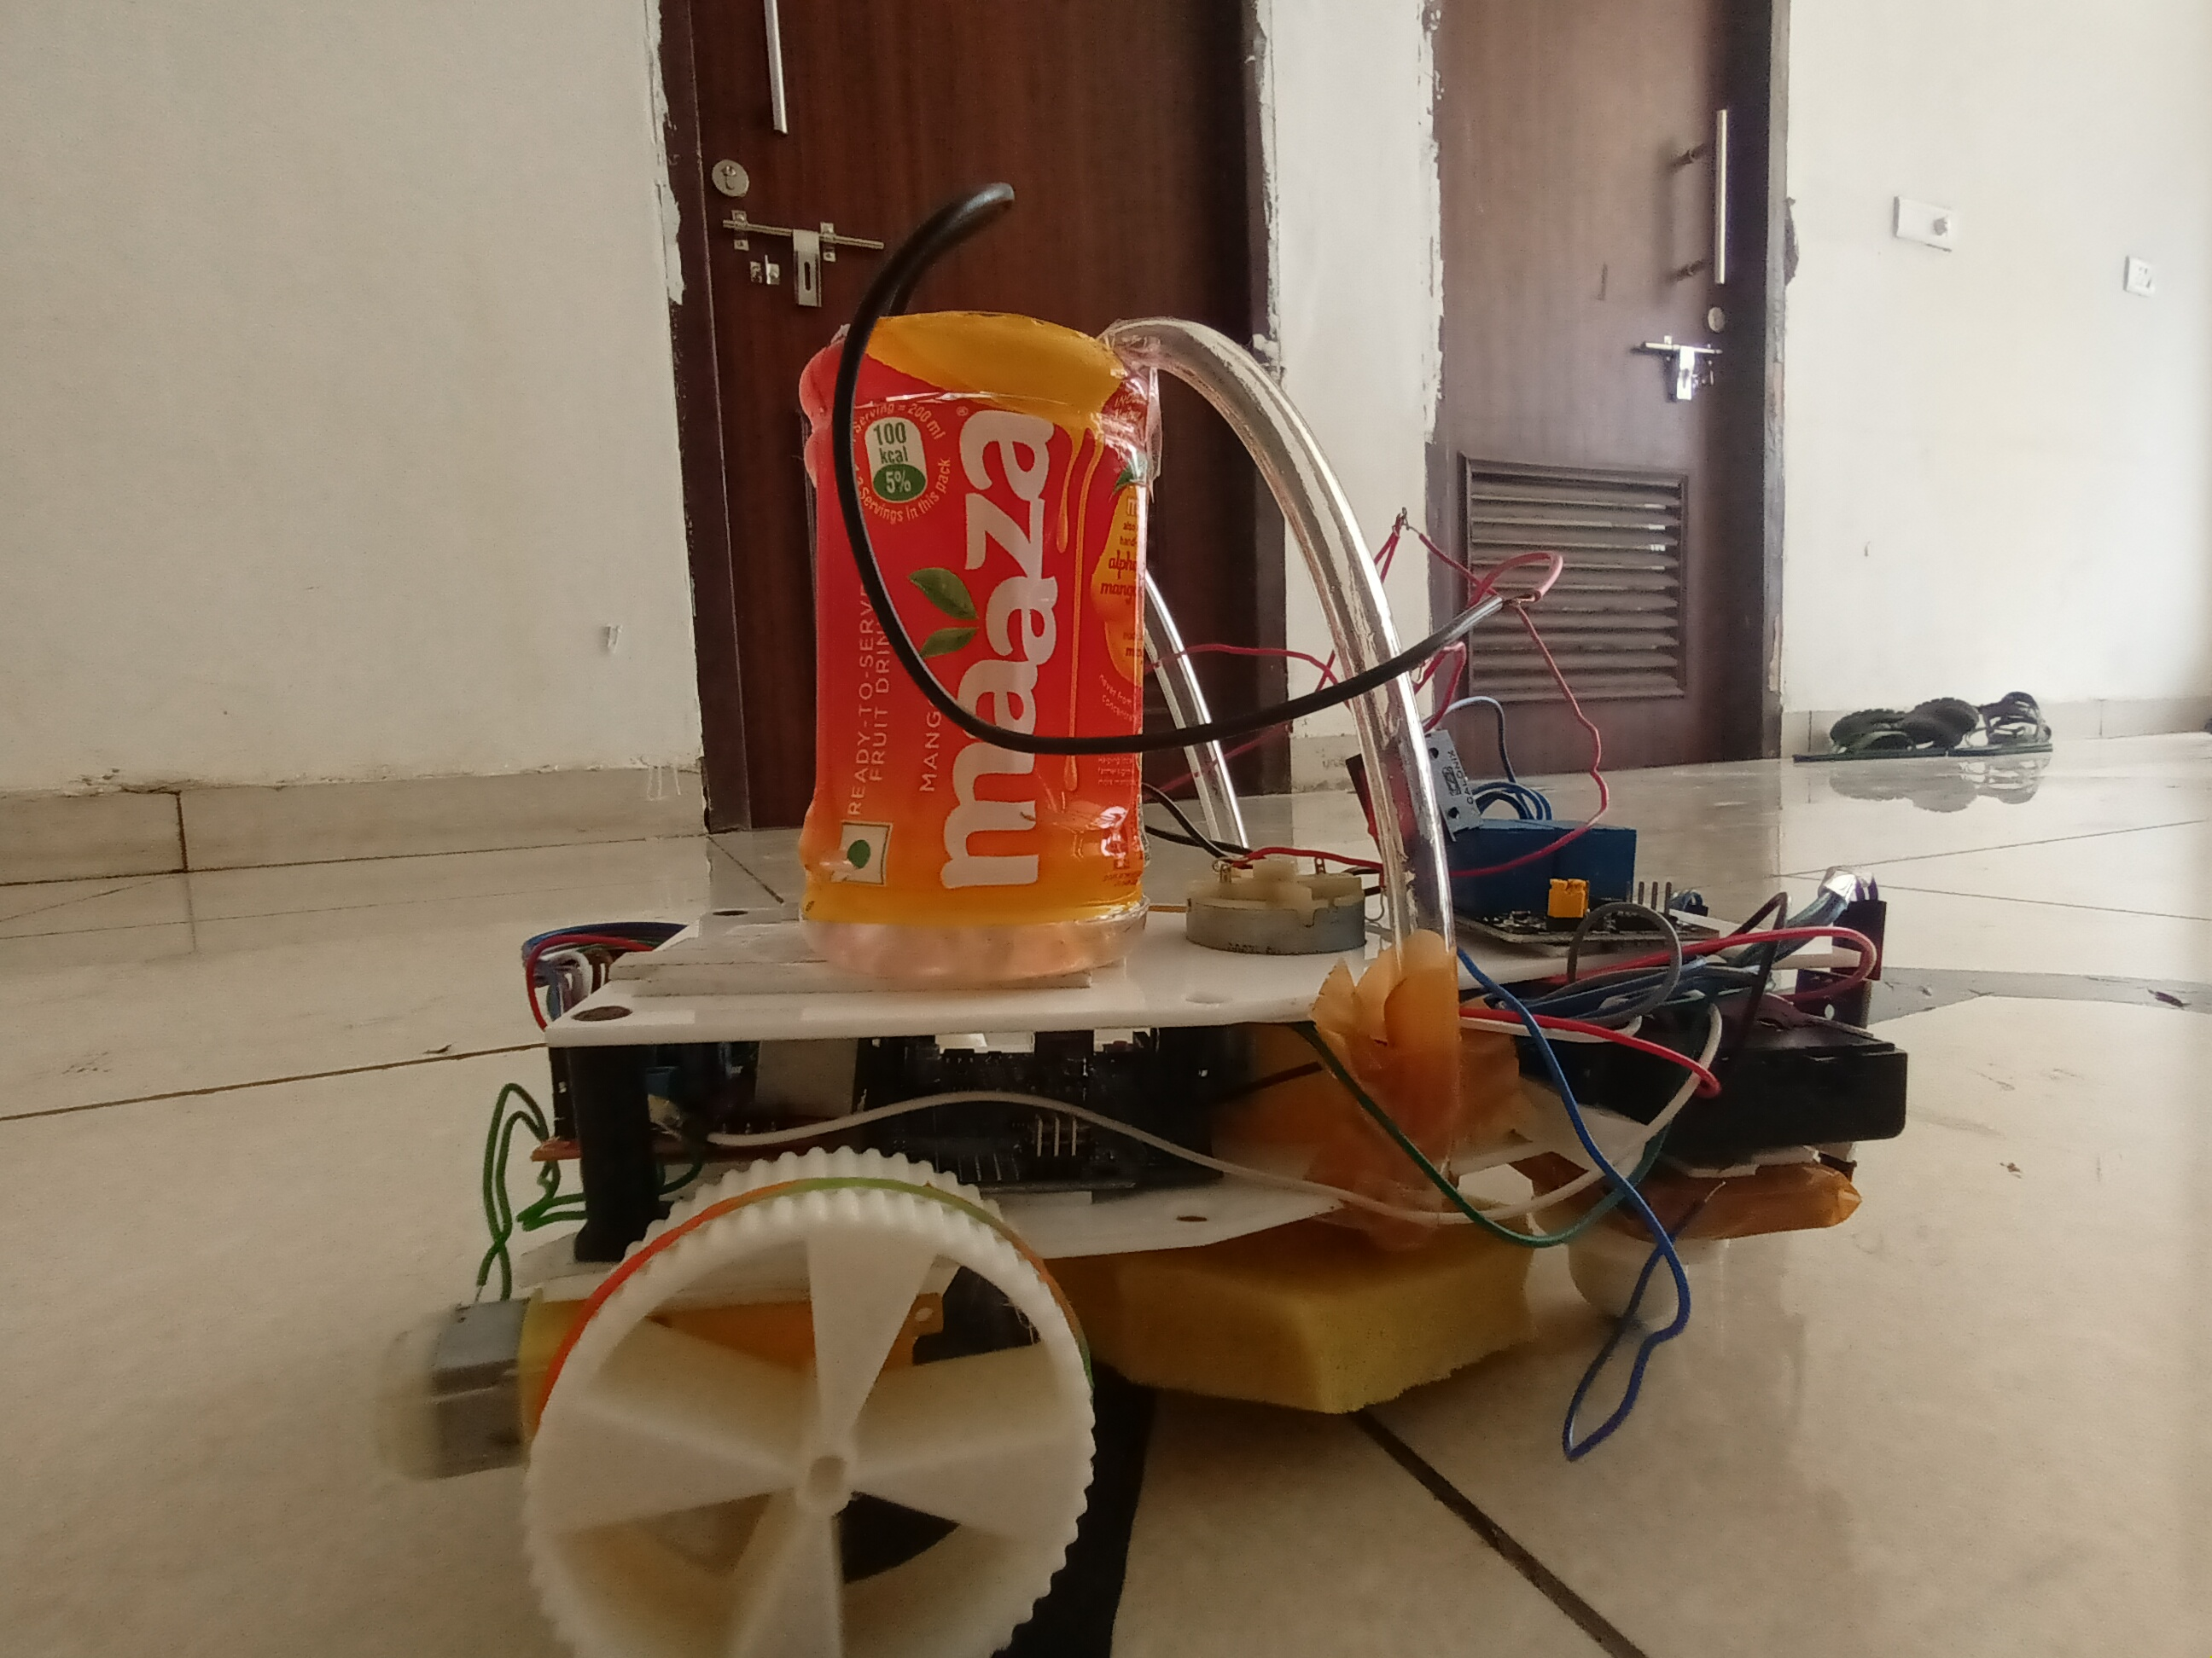
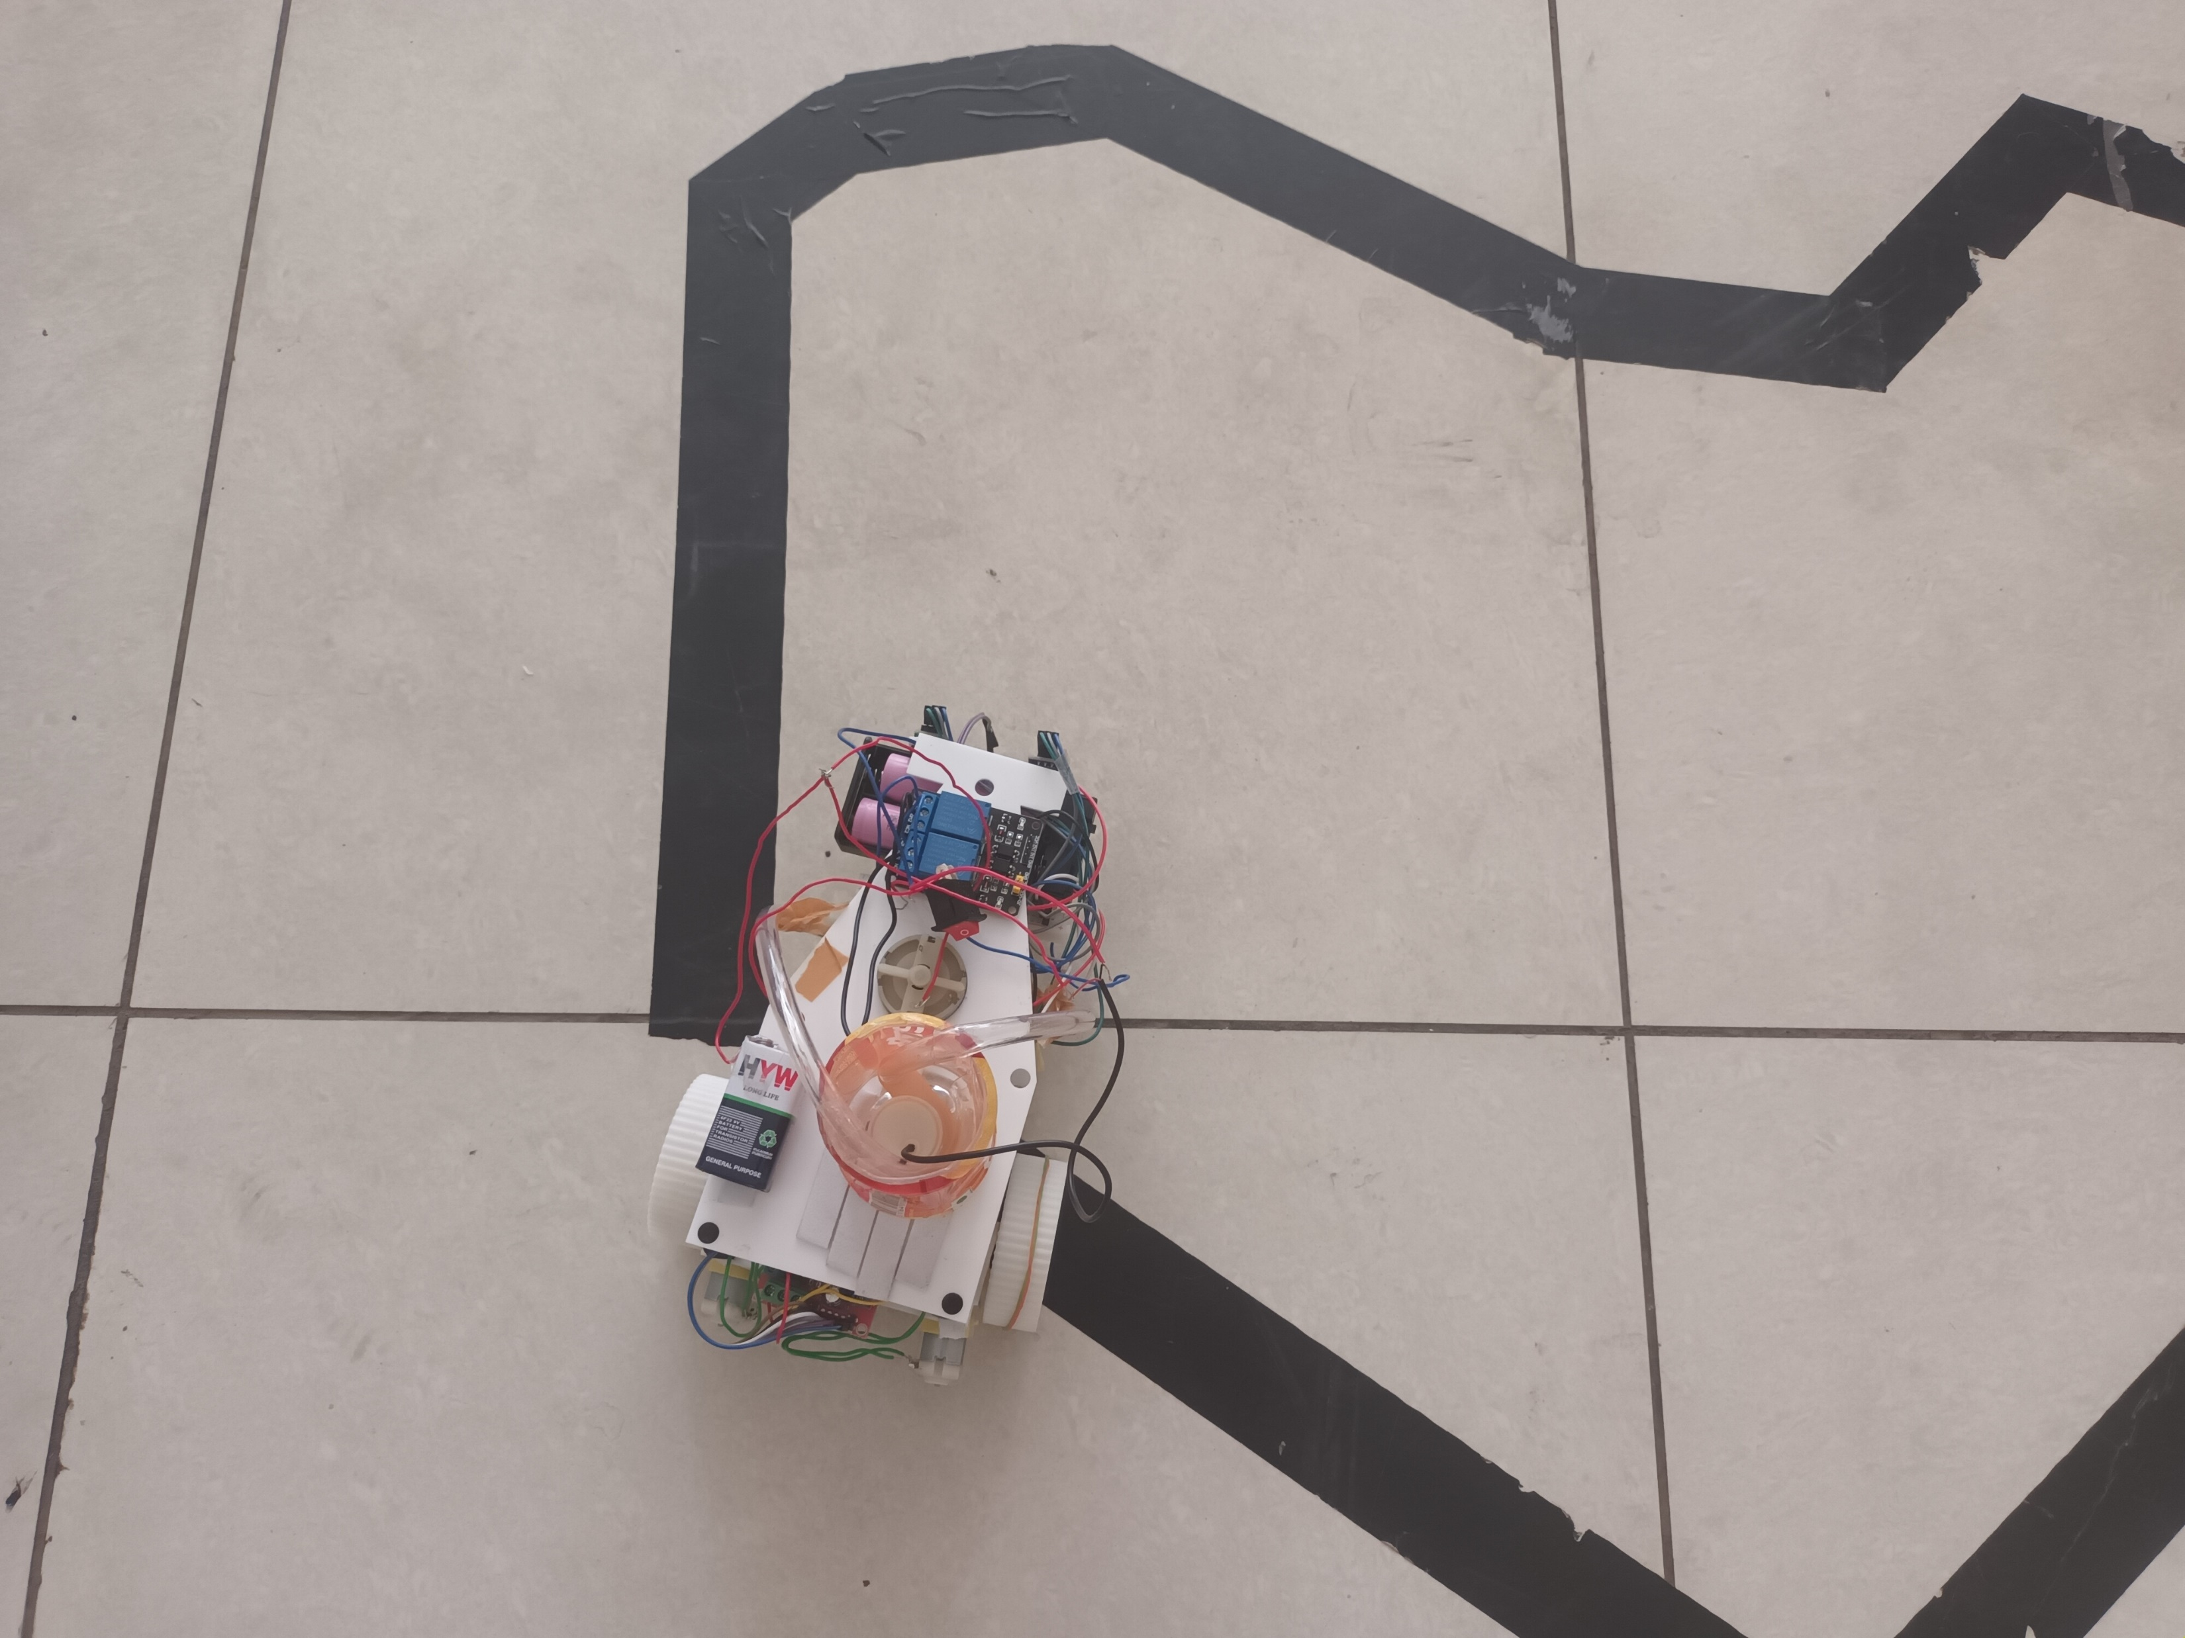
ACTUAL IMAGES

Slide 22
KEY LEARNINGS:
Acquired knowledge of the integration and calibration of infrared sensors.
Algorithm Development: It gives students practical experience in putting control theory into real-world situations.
Hardware design: It is the process of creating the robot's external framework, which includes the motor configurations and chassis.
Problem- Solving: Enhanced critical thinking.
Programming Skills: Handling obstacles like abrupt turns, junctions, and changes in line features improves robotics problem-solving abilities.
Experimentation and Rework: It required tolerance and comprehension to avoid doing the same thing twice errors.
Electronics and Wiring: Gaining experience in connecting and wiring electronic components, such as motors, sensors, and microcontrollers, gives you a practical understanding of circuit design and electronics.

Slide 23
CHALLENGES FACED IN LINE FOLLOWING:
Robots can face a number of difficulties when line following, and resolving these issues is essential to obtaining dependable performance. These are a few typical difficulties encountered when line following:
• Ambient Light Variations
• Line Width and Colour
• Sharp Turns and Intersections
• Uneven Surfaces
• Sensor Interference
• Calibration Drift

Slide 24
CONCLUSION:
To sum up, the line follower robot is an amazing example of how technology and real-world use can collide. Its capacity to use infrared sensors and complex algorithms to navigate a predetermined path autonomously not only demonstrates robotics' advancements but also opens up a wide range of practical applications. The line follower robot is a flexible tool that can be used for both industrial automation and educational projects to improve productivity and learning. We can expect more advancements in line follower robots as technology develops, opening the door for greater accuracy, flexibility, and integration into a wider range of applications.

Slide 25
THANK YOU!!

